Slide 1


Recommender systems
3912063
Presented by: Sasha Nazareth
I I certify that this is all my own original work. If I took any parts from elsewhere, then they were non-essential parts of the assignment, and they are clearly attributed in our submission. I will show I agree to this honor code by typing “Yes”: YES

Slide 2
How the solution provided, improves performance of KNN based collaborative filtering:-
Item popularity- the calculation of the item popularity signifies the importance of the most popular items in the dataset. It gives an idea of which item is rated the most. For instance, for the dataset 416 times an item was rated which is the maximum.
The higher the item is rated= higher the popularity of item.
This will help us in providing a good recommendation for users who have similar likes too. It makes the recommendation stronger.
Weight calculation- to calculate the weight is a very interesting part. It takes a different perspective. Weight gives importance to the less significant items. It does not ignore the less popular items. Rather it suggests, the less popular items represent a higher significance than the high popular items.
Hence, in my opinion this solution does provide us a better performance because it gives importance to both aspects- high and low popular items, not only to one of them. It is a fair way to give the best recommendation.

Slide 3
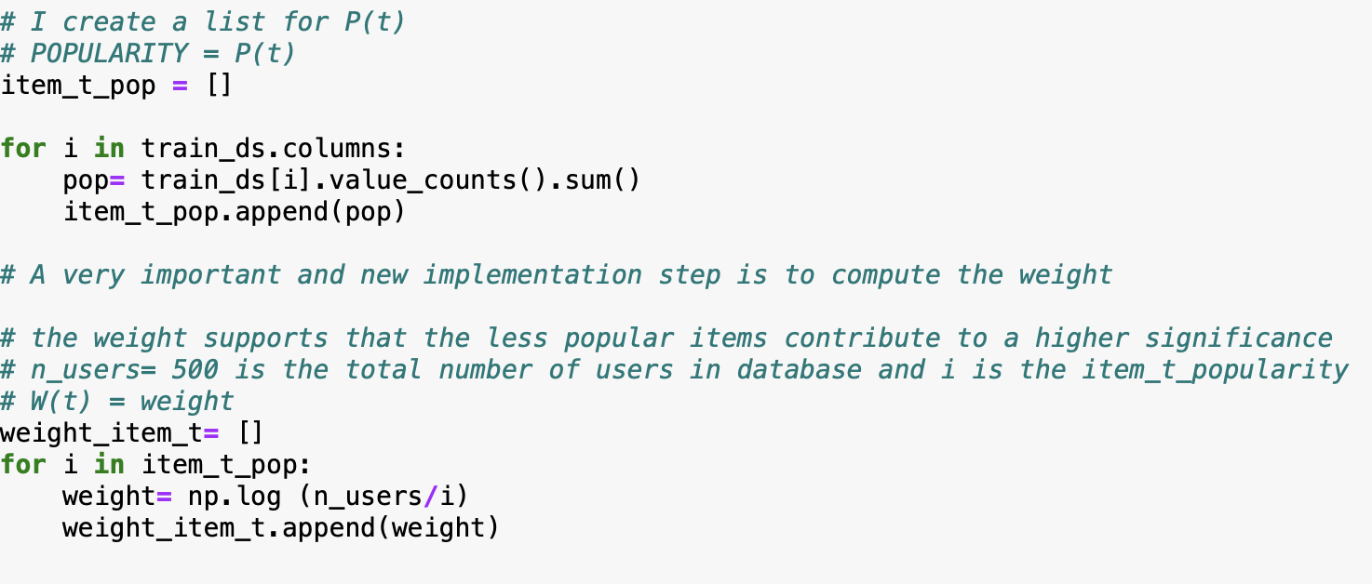
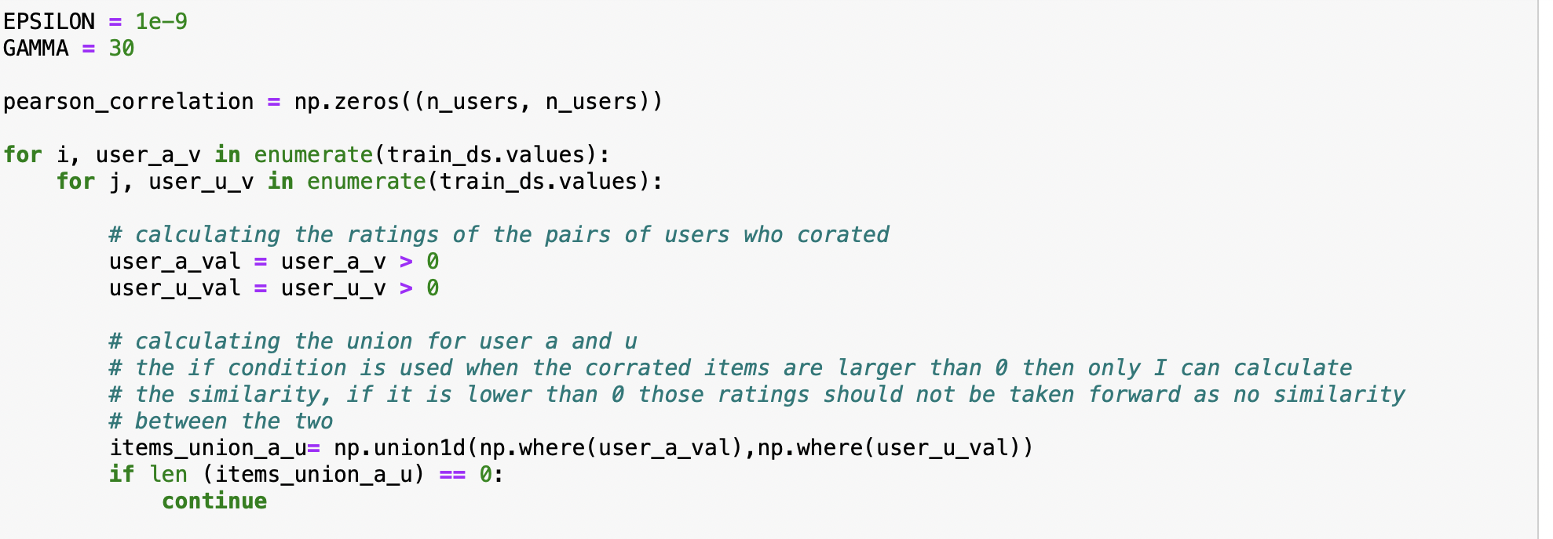
Why the solution provided, improves performance of KNN based collaborative filtering:-
Item popularity
Weight
Union of the two users

Slide 4
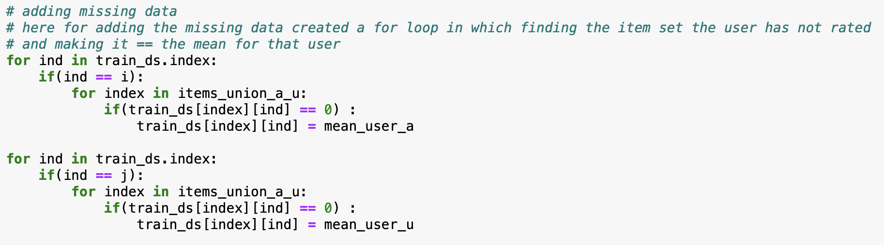
Why the solution provided, improves performance of KNN based collaborative filtering:-
In this implementation, as I am also making up for the missing data
It does not leave room for errors to occur as we move forward to calculate the PCC* because, if there are missing values it can hamper the calculation of the PCC*.
*PCC- Pearson Correlation Coefficient

Slide 5
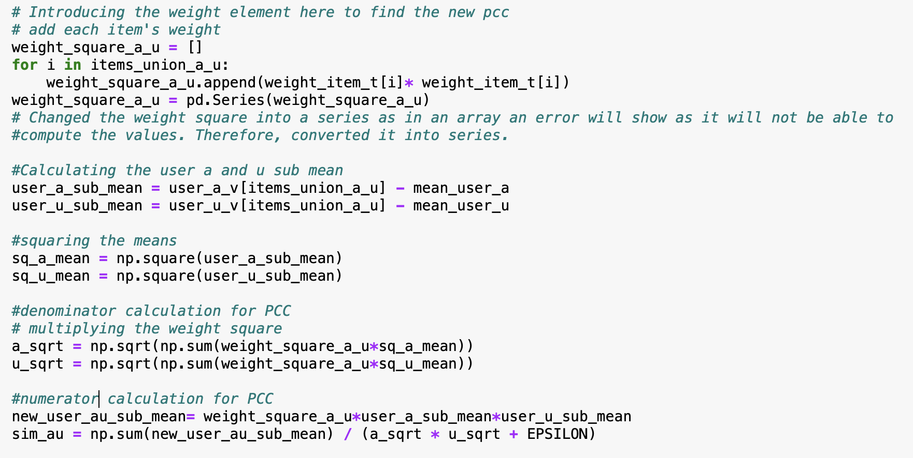
Implementation of solution
Adding the weight value in the PCC equation as now, not only will it consider the high popular items but also the low popular ones.
*PCC-Pearson Correlation Coefficient

Slide 6
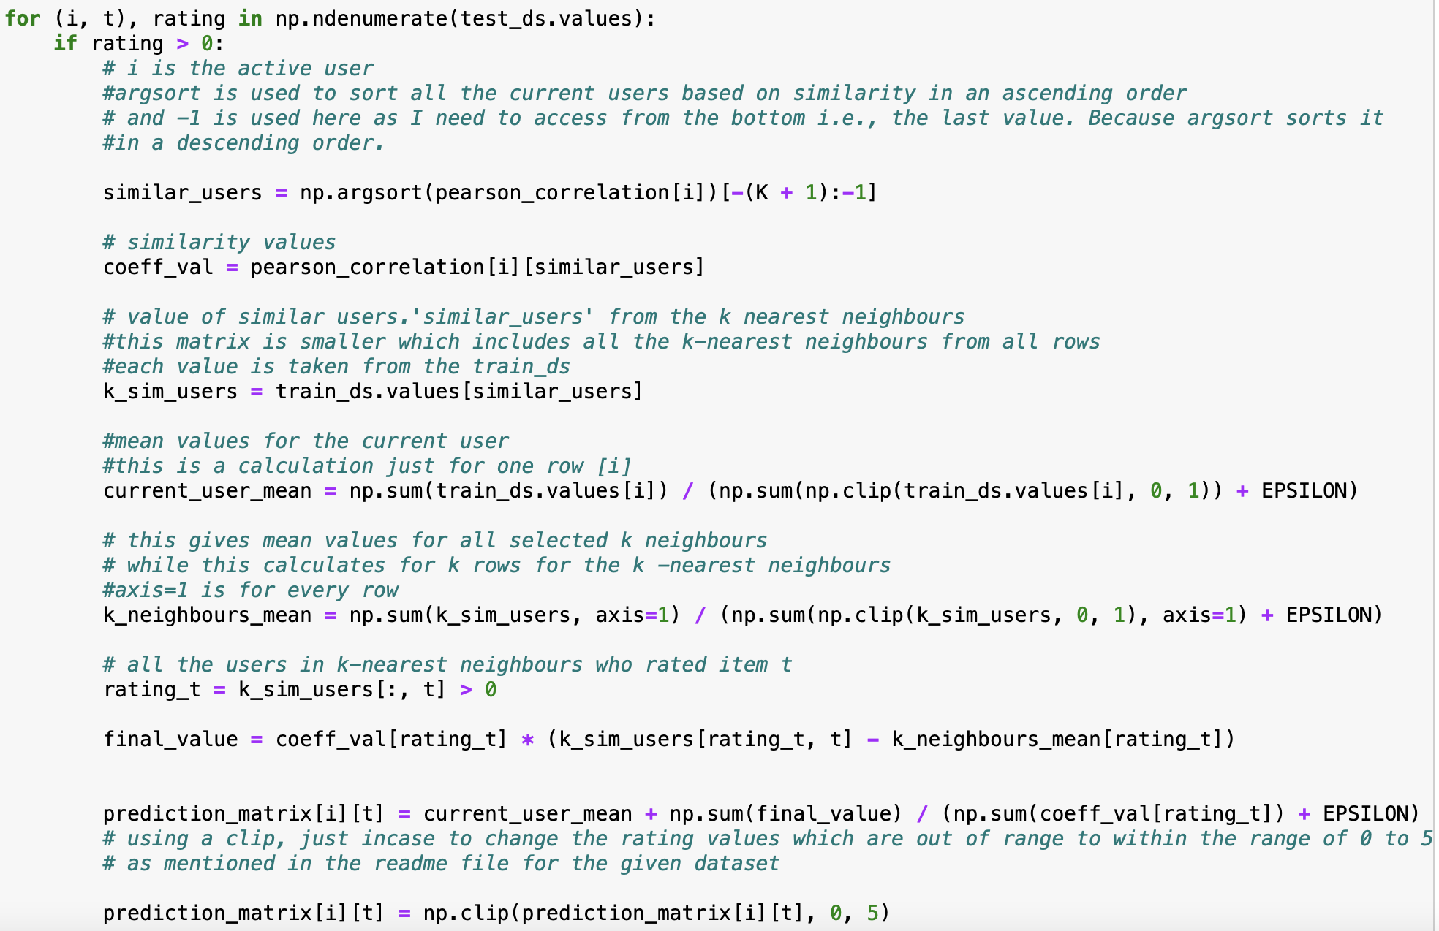
Implementation of solution
Prediction of the ratings based on KNN collaborative filtering
Here, the PCC includes the weight too and I will be incorporating that for the prediction.
USERS
A
B
C
D
MOVIE A
4 | 5 | 4 | 0
RATINGS
MOVIE B
2 | 1 | 3 | 5

Slide 7
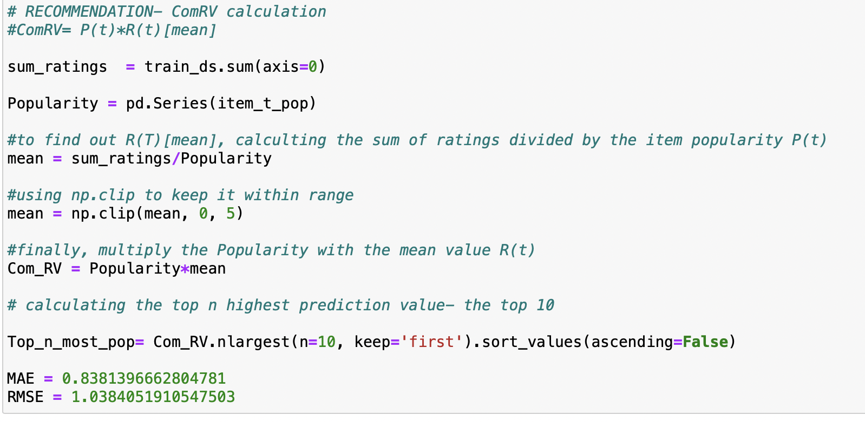
Implementation of solution
Lastly, the calculation of the Composite recommendation value for every item t.
ComRv= P(t)* R(t)
P(t)- Popularity of item t
R(t)-mean rating of value item t

Slide 8

Thank you!

